Slide 1
AF1001 Fundamentals of Accounting (BSE-3rd Semester)
Mr. Sami Ullah
Lecturer NUCES FAST Peshawar
GCR Code: iupp66m

Slide 2
STEP-7
As previously stated, revenue increases retained earnings, and expenses and dividends decrease retained earnings. If the only financial statement that we needed was a balance sheet, these changes in retained earnings could be recorded directly in the Retained Earnings account.
However, owners, managers, investors, and others need to know amounts of specific revenues and expenses and the amount of net income earned in the period. Therefore, separate ledger accounts must be maintained to measure each type of revenue and expense, and to account for dividends declared.

Slide 3
Temporary Accounts:
Revenue, expense, and dividends accounts are called temporary, or nominal, accounts, because they accumulate the transactions of only one accounting period.
At the end of an accounting period, the changes in retained earnings accumulated in these temporary accounts are transferred into the Retained Earnings account. This process serves two purposes.
First, it updates the balance of the Retained Earnings account for changes occurring during the accounting period.
Second, it returns the balances of the temporary accounts to zero, so that they are ready for measuring the revenue, expenses, and dividends of the next accounting period.

Slide 4
Permanent Accounts
Retained Earnings and other balance sheet accounts are called permanent, or real, accounts, because their balances continue to exist beyond the current accounting period.
Transferring the balances of the temporary accounts into the Retained Earnings account is called the closing process.
The journal entries made for the purpose of closing the temporary accounts are called closing entries.
While adjusting entries are usually made on a monthly basis, it is common practice to close accounts only once each year. Thus, we will demonstrate the closing of the temporary accounts of Overnight Auto Service at December 31, 2011, the end of its first year of operations.

Slide 5
The closing process
The closing process is relatively straightforward and involves just four steps:
closing all revenue accounts to the Income Summary,
closing all expense accounts to the Income Summary,
closing the Income Summary to Retained Earnings, and
closing the Dividends account to Retained Earnings.
Again there is a need of adjusted trial balance of Overnight Auto service in order to know the exact amount of temporary accounts to close. So a figure 5-1 is given again in next slide for referring the closing process.

Slide 6
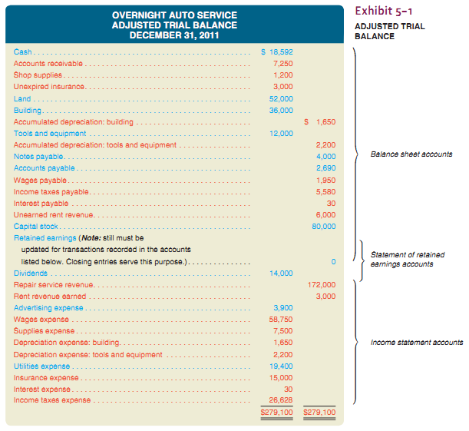

Slide 7
CLOSING ENTRIES FOR REVENUE ACCOUNTS
Overnight uses two revenue accounts:
(1) Repair Service Revenue, which had a credit balance of $172,000 at December 31, 2011, and
(2) Rent Revenue Earned, which had a credit balance of $3,000 at December 31, 2011.
Two separate journal entries could be made to close these accounts, but the use of one compound journal entry is an easier, time-saving method of closing more than one account. The compound closing entry for Overnight’s revenue accounts is displayed in Exhibit 5–3.

Slide 8
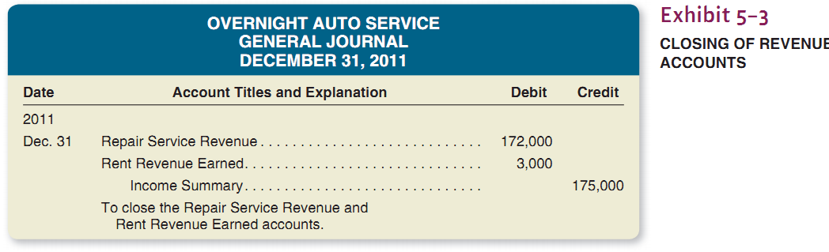
After this closing entry has been posted, the two revenue accounts each have zero balances, whereas Income Summary has a credit balance of $175,000, as illustrated in Exhibit 5–4 .

Slide 9
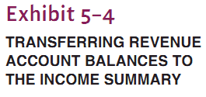
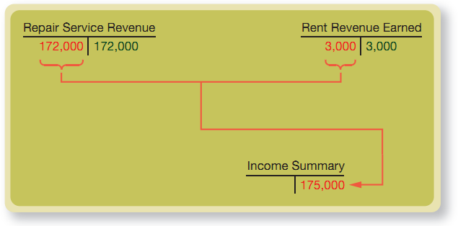

Slide 10
CLOSING ENTRIES FOR EXPENSE ACCOUNTS
Expense accounts have debit balances. Closing an expense account means transferring its debit balance to the Income Summary account. The journal entry to close an expense, there-fore, consists of a credit to the expense account in an amount equal to its debit balance, with an offsetting debit to the Income Summary account.
There are nine expense accounts in Overnight’s ledger (see the adjusted trial balance in Exhibit 5–1 ). Again, a compound journal entry is used to close each of these accounts. The required closing entry is displayed in Exhibit 5–5.

Slide 11
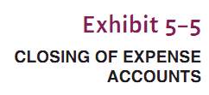
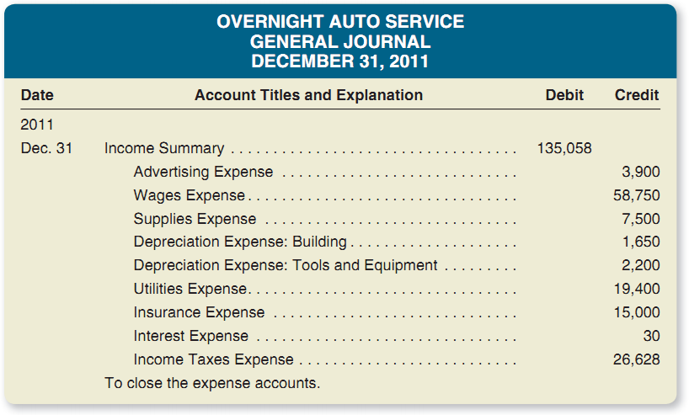
After this closing entry has been posted, the Income Summary account has a credit balance of $39,942 ($175,000 credit posted minus the $135,058 debit posted), and the nine expense accounts each have zero balances as shown in Exhibit 5–6 (shown in next slide) . This $39,942 credit balance equals the net income reported in Overnight’s income statement.
Had the company’s income statement reported a net loss for the year, the Income Summary account would have a debit balance equal to the amount of the loss reported.

Slide 12
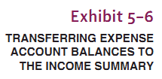
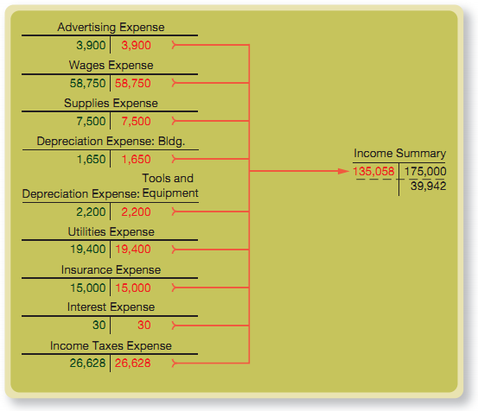

Slide 13

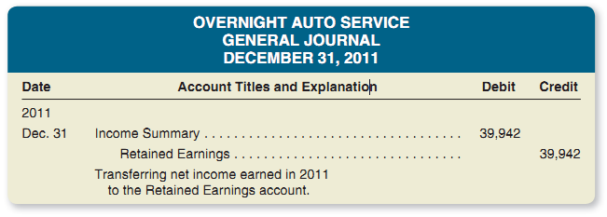
CLOSING THE INCOME SUMMARY ACCOUNT
The net income of $39,942 earned during the year causes an increase in Overnight’s owners’ equity. Thus, the $39,942 credit balance of the Income Summary account is transferred to the Retained Earnings account by the closing entry in Exhibit 5–7.

Slide 14
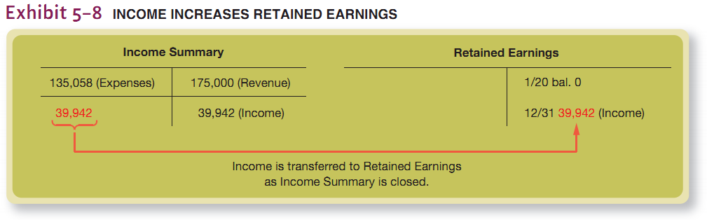
After this closing entry has been posted, the Income Summary account has a zero balance, and the net income for the year ended December 31, 2011, appears as an increase (or credit entry) in the Retained Earnings account as shown in Exhibit 5–8 .

Slide 15

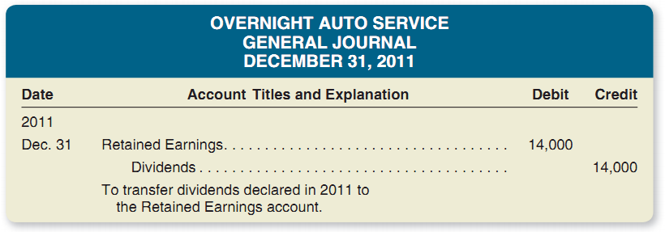
CLOSING THE DIVIDENDS ACCOUNT
As explained earlier in the chapter, dividends to stockholders are not considered an expense of the business; therefore, they are not taken into account in determining net income for the period. Since dividends are not an expense, the Dividends account is not closed to the Income Summary account. Instead, it is closed directly to the Retained Earnings account, as shown in Exhibit 5–9.

Slide 16
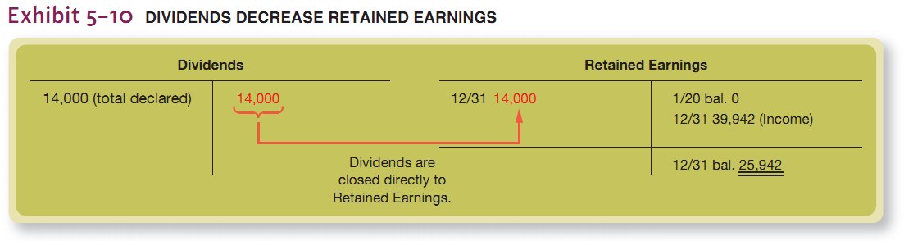
After this closing entry has been posted, the Dividends account will have a zero balance, and the Retained Earnings account will have an ending credit balance of $25,942, as shown in Exhibit 5–10.

Slide 17
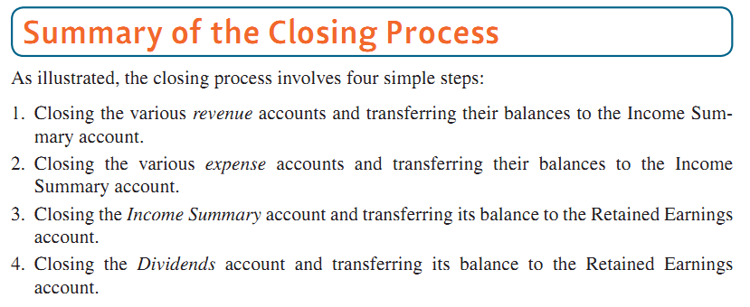

Slide 18

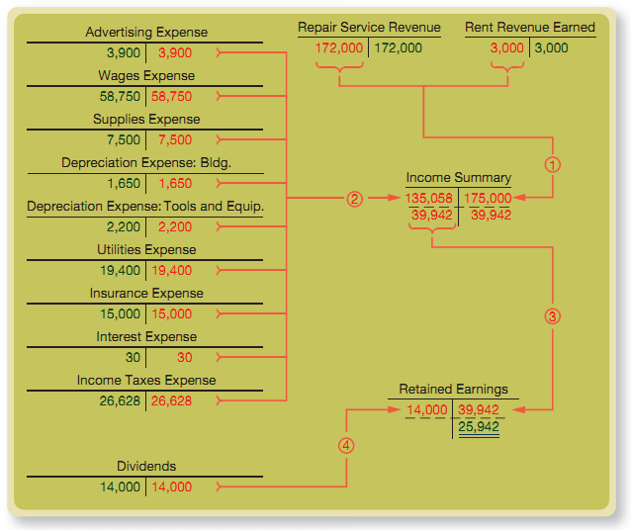
The entire closing process is illustrated in Exhibit 5–11 using T accounts.

Slide 19
STEP-8
After the revenue and expense accounts have been closed, it is desirable to prepare an after-closing trial balance that consists solely of balance sheet accounts. There is always the possibility that an error in posting the closing entries may have upset the equality of debits and credits in the ledger. The after-closing trial balance, or post-closing trial balance as it is often called, is prepared from the ledger. It gives assurance that the accounts are in balance and ready for recording transactions in the new accounting period. The after-closing trial balance of Overnight Auto Service is shown in Exhibit 5–12.

Slide 20

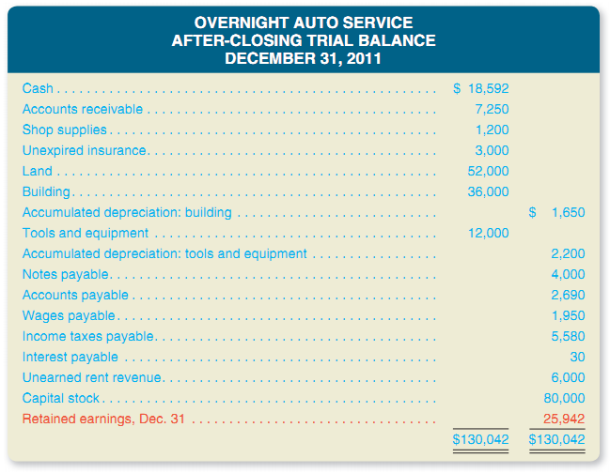
In comparison with the adjusted trial balance in Exhibit 5–1 , an after-closing trial balance contains only balance sheet accounts.
Also, the Retained Earnings account no longer has a zero balance. Through the closing of the revenue, expense, and dividends accounts, the Retained Earnings account has been brought up-to-date.

